Slide 1
Your Environment, Your Health
Community Outreach and Engagement Core
Environmental Health Sciences Center

Slide 2
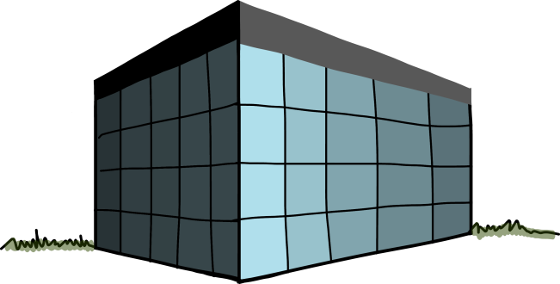
What is Environmental Health?
Environmental Health examines how our environment, both natural and man-made, can affect our health.
Notes:
What do you think about when you think of the term “environmental health”? Scientists look at environmental health as how our environment can affect our health, good or bad. Here we have some examples of different environments we might pass through during the day – school, a forest, work, the beach, a park. What are some other examples of environments we live in?

Slide 3
What is Environmental Health?
Environmental Health examines how our environment, both natural and man-made, can affect our health.
So what is in our environment?
To understand how our health might be affected, we need to know
What chemicals we are exposed to
How we are exposed
The amount we are exposed to, and for how long
Notes:
In all these environments, there are things that can affect our health. For example, when you walk through the forest, maybe the clean air makes you feel relaxed. What scientists focus on though, are the chemicals in our environment. In order to understand if our environment is affecting our health, we need to know what is in our environment. We also need to know how we are exposed, and how much we are exposed to. Before we get into that though, I want to ask a few questions about chemicals. Just raise your hand if you agree: “chemicals are bad for humans.” Ok now raise your hand if “chemicals are good for humans.” Alright, now raise both hands if you think they can be both. Chemicals are not necessarily good or bad for humans – it depends on how they get into your body, and how much gets into your body. What are some examples of different chemicals?

Slide 4
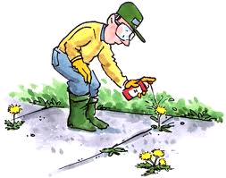
Chemicals
Chemicals are found in everything!
Air is a chemical. Water is a chemical.
So are all chemicals bad?
No! Some chemicals do have the potential
to be harmful though. That is why scientists
test every new chemical before letting people use it.
Notes:
Air is made of nitrogen and oxygen – both of these are chemicals. Water is made of hydrogen and oxygen. Even salt (sodium and chloride) is made of chemicals. Humans are made up of chemicals! So we need chemicals for life. But some chemicals can be harmful. With that in mind, here’s something else to think about. Raise your hand when I say something you think is true. “Natural chemicals, chemicals found in our environment, are better than chemicals that are made in a lab.” “Chemicals made in a lab are safer than natural chemicals.” “The safety of a chemical doesn’t matter if it is natural or made in a lab.” The safety of a chemical is not determined by its source. There are some very dangerous natural chemicals – think about the chemicals released by poison ivy!

Slide 5
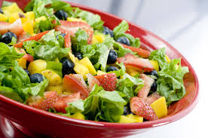
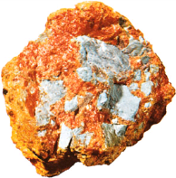
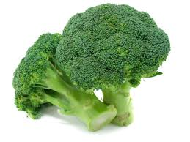
What are some of the ways we are exposed to chemicals in our environment?
The food we eat
The air we breath
The water we drink
Pollution
Pesticides
Forest fires
Others?
Notes:
So we have talked about our environment, and we have talked about chemicals in our environment. But we haven’t talked about how these chemicals can get into our body. Once they are in our body, they have the chance to affect our health. So what are some of the ways we are exposed to chemicals? Keep in mind, being exposed to a chemical isn’t a bad thing – it just means the chemical can get into our body. When you take a drink of water, you could say you had just been exposed to water!

Slide 6
How are we exposed to chemicals?
Notes:
So we have talked about different sources of chemicals. Now we need to understand how they get into our body. There are scientists called toxicologists who study the effect of chemicals once they get into the body. What is very important to a toxicologist is understanding how those chemicals get into the body. A toxicologist focuses on three main routes of exposure. What are the ways a person can be exposed to chemicals?
For teachers – there are more than three routes, but we will focus on the three routes that a person can be exposed to chemicals through their environment. If students use more common terms (eating, drinking, breathing, touching), ask them to then brainstorm the other words that describe these actions.
Ingestion – eating, drinking
Inhalation – breathing
Dermal – touching
Other routes:
Intravenous injection – this will not occur simply by interacting with your environment (to keep it appropriate though, if students ask, you can say it would occur in the environment of a Drs. office as they get a vaccination
Intramuscular injection – same as above (think tetanus shot)
Intraperitoneal injection – same as above (used to be how rabies shots were administered)

Slide 7
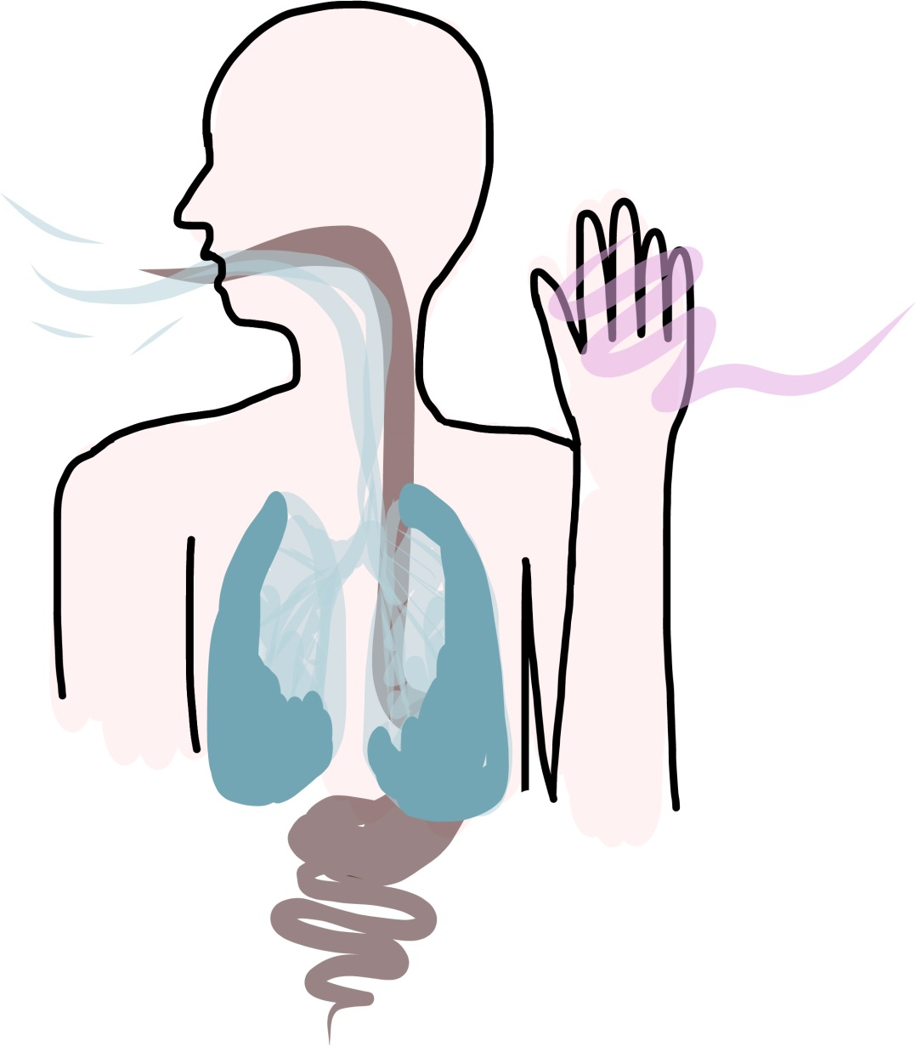
Basics of Exposure
Inhalation
(Breathing)
Dermal
(skin contact)
Ingestion
(Eating, drinking)
Notes:
The question I usually get once we have talked about routes of exposure is “so what?” Why does it matter how a chemical gets in the body? Isn’t it just important to know the chemical got in the body? These are actually really great questions. It turns out that the way a chemical gets in the body is really important for how toxic the chemical might be. So first, what does toxicity mean?
Here is an example of how the route of exposure determines the toxicity. Has everyone heard of mercury before? Maybe you remember how mercury used to be in thermometers? Mercury is a naturally occurring metal that is found in rock. Ok, so the question is, is mercury toxic? Well, it depends on how you are exposed. Who has ever seen the movie, or read the book “Alice’s Adventures in Wonderland?” Remember the Mad Hatter? Does anyone know the story behind that?
[The Mad Hatter is based off a true phenomenon, where hatters used mercury to make felt hats. After years of inhaling fumes from the mercury, they began to slur their words, talk rapidly and use nonsensical words, stumble, be irrational.] So when a person breathes in mercury fumes, that has a bad effect on their health.
But now, what if I told you that some people have fillings in their teeth that are made of mercury? Does that mean they are going to have the same symptoms as the Mad Hatter? In fact, they don’t. They are just fine. Why is that? The route of exposure is different – inhalation vs. ingestion. Turns out that if a person is exposed to mercury through inhalation, that results in strong toxicity. Ingestion or dermal exposure has very low toxicity. So the way a person is exposed to a chemical can be very important.

Slide 8
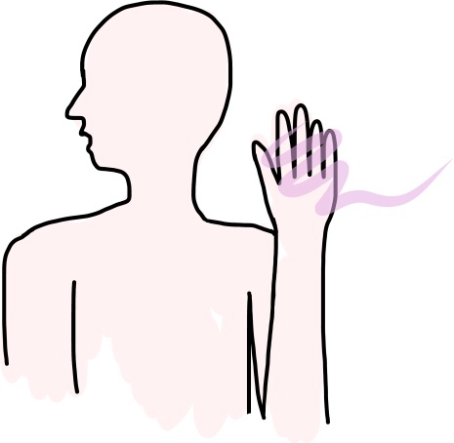
Route of Exposure: Dermal
Factors affecting skin exposure
Watery or oily skin
Existing cuts or injuries
Notes:
Lets look at each type of exposure, and understand how it works. Dermal exposure is when you are exposed to a chemical through touching. Our skin is actually a very strong barrier to chemicals, but there are ways a chemical can absorb through our skin – this is if our skin is watery or oily – for example if you had just put lotion on.
Optional example: There is a compound called DMSO that absorbs very quickly through the skin. It has painkiller properties, so has been put in a lotion used to treat arthritis. But imagine this – you’ve just put this lotion on, that absorbs through your skin really well. Imagine if you now went out into your garden, and started applying pesticides. What do you think would happen? [pesticides would absorb through skin)
Plus, if you have cuts or injuries, chemicals can get into your bloodstream that way.

Slide 9
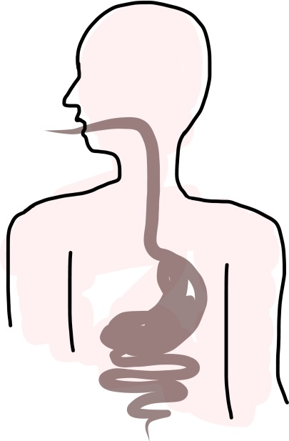
Route of Exposure: Ingestion (eating/drinking)
Most absorption occurs in the small intestines.
The lining of the intestinal tract is only one cell thick
and has an extremely large surface area.
http://learn.genetics.utah.edu/content/cells/scale/
How large is a cell? Can we see it?
A cell is 200 times smaller than a sesame seed
Notes:
The interesting thing about this route of exposure is that you aren’t actually exposed to any chemicals until they get to the small intestines! The amount that can absorb while it is in your mouth or your stomach is actually very small. The other important thing is that the chemicals have to be small enough to absorb through your small intestine into your body. So just how small is a chemical then? This interactive graphic from the University of Utah shows the size of a cell, and then the size of water. (follow link to on-line activity). If the chemical is too big, it won’t be absorbed, and will just pass through the body, so you are not exposed.

Slide 10
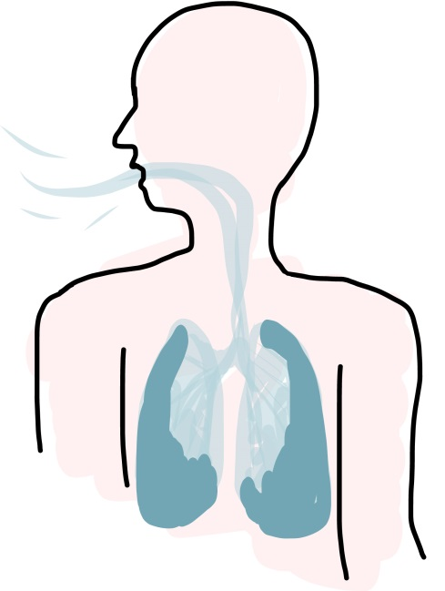
Route of Exposure: Inhalation
Adults breathe several cubic meters of air per day, dependent on activity level.
Gases or vapors can enter the bloodstream when they are inhaled.
Notes:
The final route of exposure is inhalation. There are chemicals in the air that we can inhale. Once again though, the chemicals have to be small enough that they can absorb across our lungs, into our bodies. Many times the chemicals are stuck to particles in the air, like dust. We can breathe in the dust, which can be really small (see graphic), and then the chemicals stuck on the dust can be absorbed into our bodies.

Slide 11
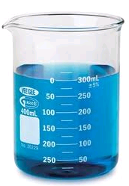
Amount of Exposure
This is called dose – how much of the chemical were you exposed to?
Different doses cause different responses.
Example: Tylenol
Take two Tylenol for a fever
Dose: 2 pills
Response: Fever and aches and pains go away
What happens if you take too many Tylenol?
Dose: 5 pills
Response: Ringing in the ears, upset stomach, dizzy
Notes:
At the very beginning of this, we said that in order to understand if a chemical could affect our health, we needed to know (1) what the chemicals is, (2) how we were exposed to the chemical, (3) the amount of the chemical and how long. So why does the amount matter?
Think about Tylenol as an example.

Slide 12
Duration of Exposure
The length of time a person (or animal) is exposed to a chemical is critical to determine toxicity.
Duration and frequency contribute to toxicity.
Duration = Length of exposure time
Frequency = Number of exposures
Notes:
The effect of a chemical can also depend on how long you are exposed. Let’s use the Mad Hatter as an example again. Let’s say he had only ever made one hat in his entire life, and then he quit. Would he have the same symptoms as a hatter who never quit? He wouldn’t – the difference is because he was only exposed once, for a short time, versus the other guy, who was exposed over his entire life. But sometimes, one exposure is enough. For example, poison ivy! Just being exposed once, even for a few seconds, is enough to get a rash!
There are some good examples too – a single healthy meal every month isn’t going to have the same effect as healthy food every meal for a month.

Slide 13
How can you reduce health effects from exposure to chemicals?
Notes:
So if you are exposed to chemicals that might have some negative effects, what can you do to prevent that? Let’s learn about some ways to safely use chemicals.

Slide 14
Risk
The probability of harm resulting from exposure to a hazard
Notes:
Sometimes the chemicals we are exposed to come from work. So if a chemical has the possibility to cause harm, we call it a hazard. But it can only be hazardous if we are exposed to it! We can use ‘personal protective equipment’ to prevent exposure. So what are different types of personal protective equipment?

Slide 15
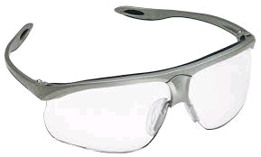
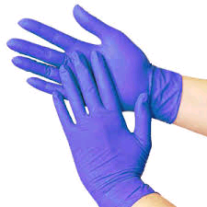
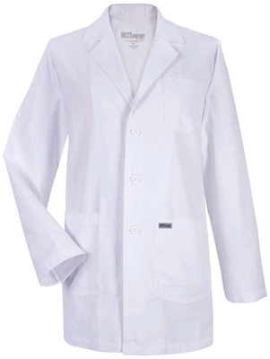
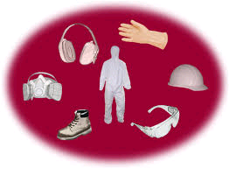
Personal Protective Equipment
Used to reduce your risk of exposure
Safety glasses
Gloves
Jacket/lab coat
Notes:
Glasses can prevent liquids from splashing into your eyes. Gloves can prevent chemicals from absorbing across your skin. A lab coat/jacket can protect your arms.

Slide 16
Reducing Risk and Exposure: Inhalation
Keep windows open when using cleaning products
Try to avoid sprays when possible
Notes:
So what about exposure to chemicals at home? How many people clean their house? Have you ever been cleaning the bathroom, and noticed you got a slight headache? That can happen when you are using cleaning chemicals and you forgot to open a window or leave the door open. If you leave the window open, or turn on a fan, that lessens the amount of cleaning chemicals you might breathe in.

Slide 17
Reducing Risk and Exposure: Ingestion
Never put a chemical mixtures into anything but its original container.
Store cleaning chemicals in a safe, separate area
Don’t use chemicals around food that is being prepared
Notes:
In the home, we have a lot of control over what chemicals get into our food. It is very important to read the labels of the chemicals we use to understand how we could be exposed. Here are some practical suggestions to minimize how we are exposed to chemicals.
Never pour chemicals into reused bottles. Why do you think that is? (Chemical residue from the bottle could mix with the new chemical, i.e. ammonia and bleach – makes chlorine gas). The bottle won’t have the label, and once you pour in the chemical, you might forget what it is. If there is no label, people might get confused – see case study below.
If you are cooking with raw chicken, you obviously want to clean the area really well afterwards. When you do that, just make sure you remove any other food in the area so you don’t spray Lysol on your salad! Then make sure you wipe down the area with a damp sponge to remove any residue.
Case study: a man mixed up a batch of paraquat (a pesticide) in his barn. He used an old glass Coca-Cola bottle. He set it down, and another man walked in. He had been in the fields, was hot, and saw a bottle of Coca-Cola. He took a drink, and was poisoned by paraquat, and hospitalized.

Slide 18
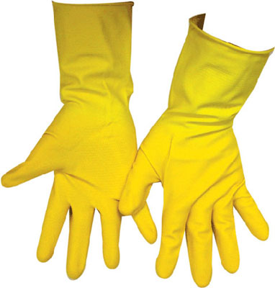
Reducing Risk and Exposure: Dermal
Wear gloves when you are cleaning
Wipe the counters down with a damp sponge afterwards
Notes:
When you are using cleaning products, wear gloves! This way the chemical can’t absorb into your skin!
Bottom line, chemicals are neither good or bad. It depends on what it is, if and how you are exposed, and the amount. Even then though, we can control if we are exposed by understanding exposure and risk.

Slide 19
THE END

